Slide 1
What are we going to see in this session?
Small scale code structure
Medium scale code structure
Large scale code structure
Sample codes for other service provider
Certification details

Slide 2
Small scale infrastructure
We can maintain very basic code structure in small-scale infrastructure.
Minimum files required are.
main.tf [provider & resource]
vars.tf [variables declared]
terraform.tfvars [variables & credentials defined]
output.tf [optional]
backend.tf [optional]

Slide 3
Medium scale infrastructure
Medium scale infrastructure are well structured with modules
Minimum files required are.
Modules
main.tf
output.tf
vars.tf
Prod
main.tf
Staging
main.tf

Slide 4
Large scale infrastructure
Pretty much same structure of medium scale is followed, but I have seen many companies used workspace to classify the state files according to environment.
Minimum files required are.
Modules
main.tf
output.tf
vars.tf
Prod
main.tf
Staging
main.tf
terraform.state

Slide 5
Sample codes for other service provider
Vmware
Azure
GCP

Slide 6
Certification details
Certification

Slide 7
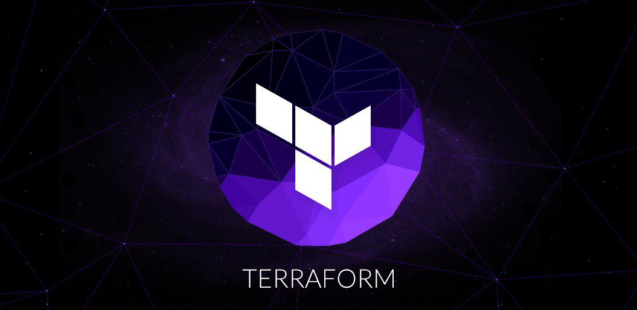
End of this topic !
Any questions?

Slide 8

Thanks!
You can find me at:
vijayprabhu.cs@gmail.com
+91-8056375375
LinkedIn
Contents @ Git-Hub

